Slide 1
Intro to Programming
Taught by Devina Dhawan and James Traver

Slide 2
Recap
Last week you learned how to write applications using MIT’s Scratch. We covered a lot of things, such as:
The Scratch IDE
Events
Logic (control flow statements)
Variables
Operators

Slide 3
This week, you’ll do that in Java!

Slide 4
An Brief Introduction to Java
Java is an object oriented programming language.
Java is also considered to be statically typed.
This means that unlike Scratch, you cannot edit your code while it runs. It also means that it is compiled, unlike scripting languages.
Java is an open source programming language.
Java was created by Sun Microsystems and is now owned by Oracle.
Java has been used in cell phones for close to two decades.

Slide 5

Android & Java
Google’s Android platform uses Java to run applications.
Android is technically an open source platform.
The Android Platform sits on top of Linux.
Linux Android Java

Slide 6
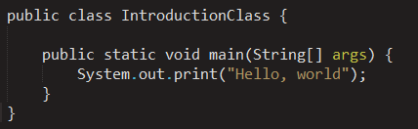
Java in a Nutshell
Because Java is object oriented, it is divided up into packages and classes. There are other structural types, but we will not be covering them today.
An application in Java named IntroductionClass.java could look like this:

Slide 7
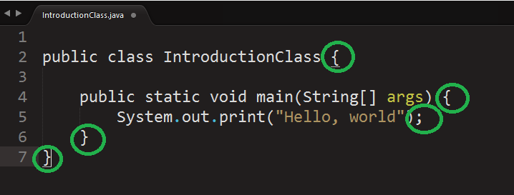
WTF are these braces?! And the semicolons?!

Slide 8
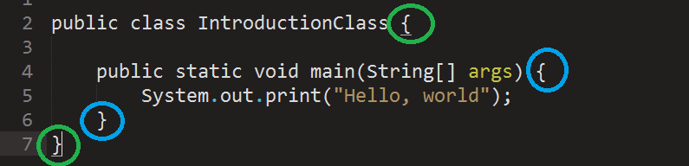
The answer isn’t exciting. Sorry.
The braces show how code is contained.
The green set of braces belong to the parent element.
The blue set of braces belong to a child element.
Semicolons are used to denote the ending of a line.

Slide 9
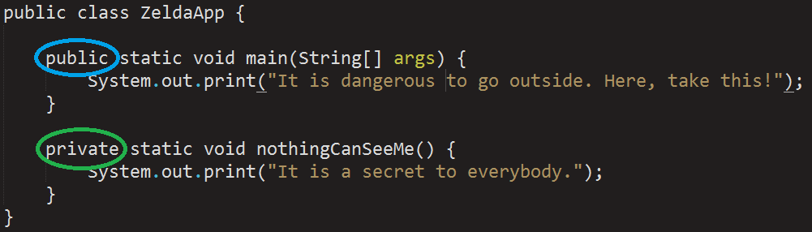
What about this public word?
Variables, classes, and methods can be either public or private.
Public means that anything, anywhere in the app can see it.
Private means that it will be hidden to anything outside of its class.
This is a product of something called inheritance but that is beyond the scope of this course.

Slide 10
But what is a Class?
You’re probably wondering what a class is and why it has suddenly just been introduced to you.
A class is a template, a definition, or a model for an object.
Think of them as a container.
They are the core of object oriented programming.
So a class is the core of objected oriented programming.
Objected oriented programming is beyond the scope of this class.

Slide 11
Okay, so how does this relate to Scratch at all?

Slide 12
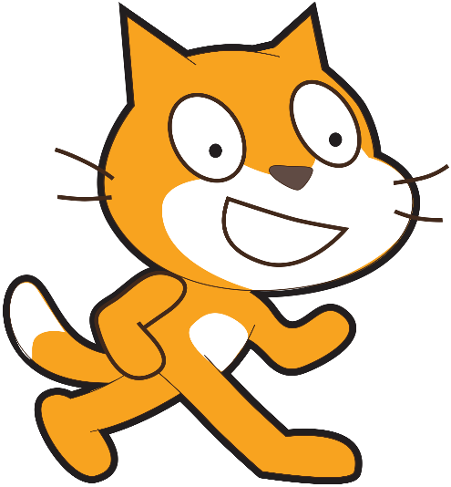
In Scratch, you have sprites
Remember how each sprite had actions?
Each sprite could move, rotate, turn, and much more.
Each sprite is an object.
So if each sprite is an object, each sprite could be a class too!
Same with the logical statements, operators, and variables!

Slide 13
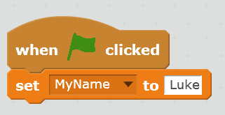
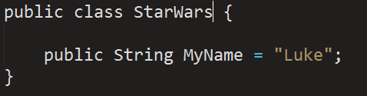
Variables
In Scratch:
In Java:

Slide 14
Basic Variables
There are many different types of variables in Java. Today, we are going to introduce you to three types:
Integer – it is an integer. No decimal places allowed. 0, 42, -3720
Double – a value with a decimal. 4.19, -8.0001, 3.14159265359
String – a text value. “Ootah gootah, Solo?”. “Over my dead body”.
Boolean – a data type that can only be true or false.
Others we won’t cover can be read about here: http://docs.oracle.com/javase/tutorial/java/nutsandbolts/datatypes.html

Slide 15
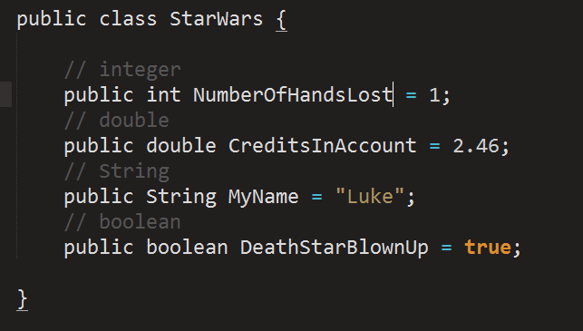
How to write variables in Java

Slide 16
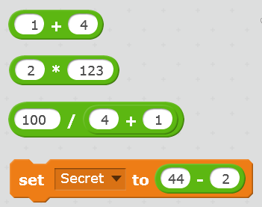
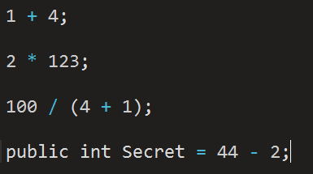
Operators and Mathematical Statements
In Scratch:
In Java:

Slide 17
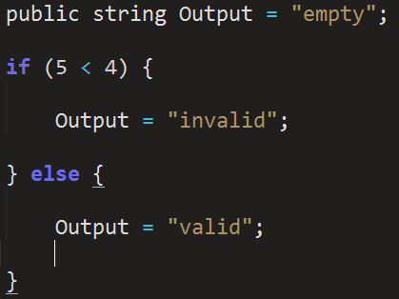
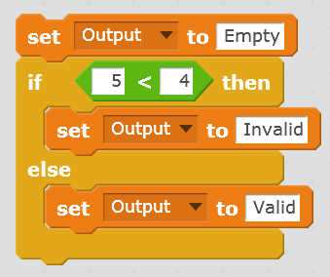
Logical Statements – If/Then
In Scratch:
In Java:

Slide 18
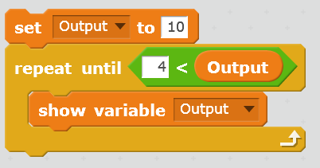
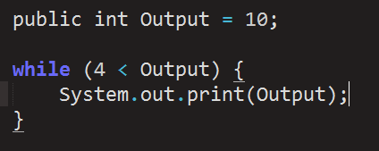
Logical Statements – While
In Scratch:
In Java:

Slide 19
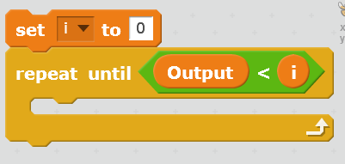
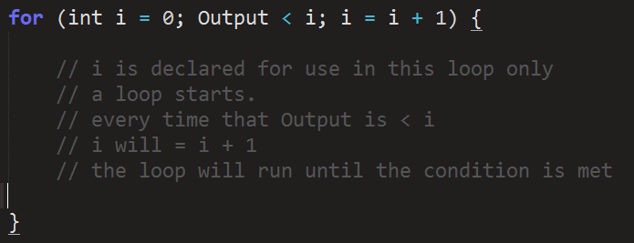
Logic Statements - Loops
In Scratch:
In Java:

Slide 20
“While” vs “Loops”
While can be used to check and see if a condition is met once.
While that condition is met, the code contained inside of it will run.
Otherwise that block of code is ignored.
Loops allow you to repeat a statement until a condition is met.
Beware of infinite loops. If your condition is never met, your code block will run forever.

Slide 21
Enough lecturing!
Now, we’re going to learn how to use Android Studio to write Java.

Slide 22
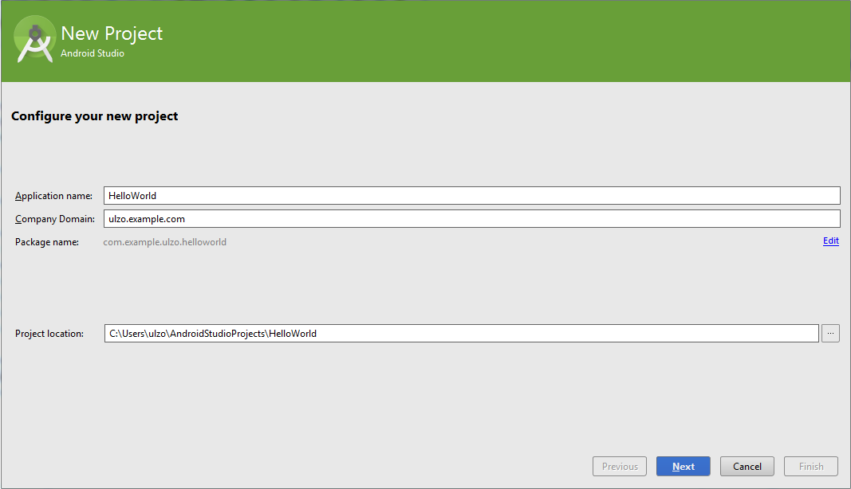

Slide 23
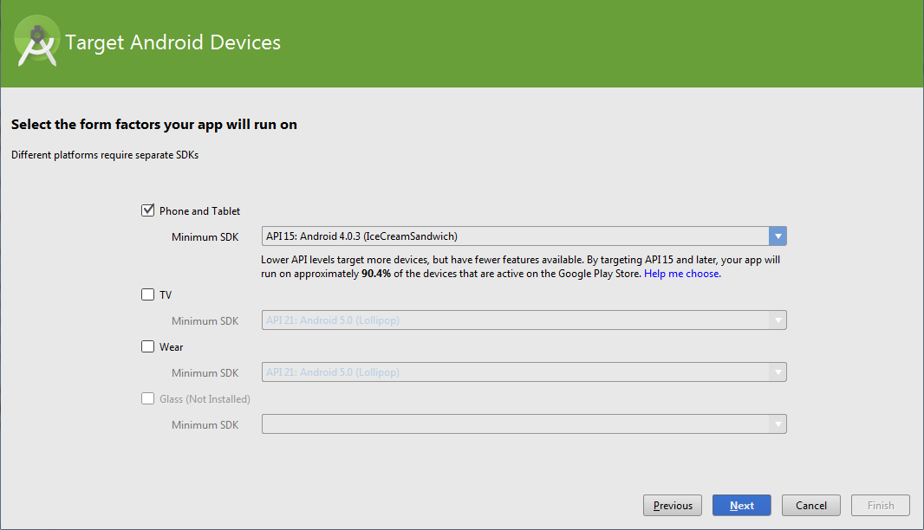

Slide 24
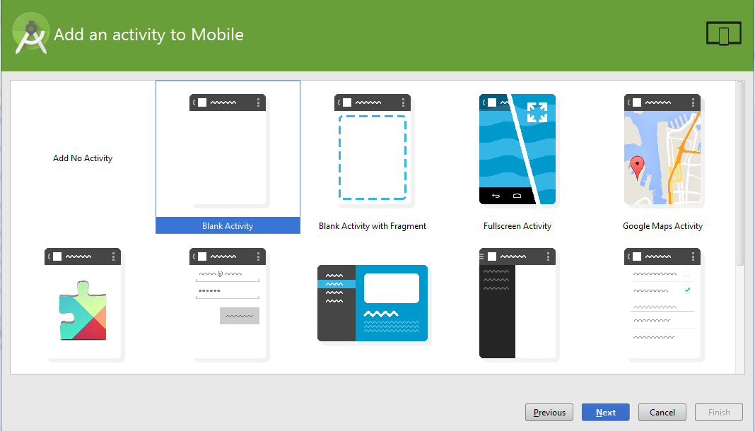

Slide 25
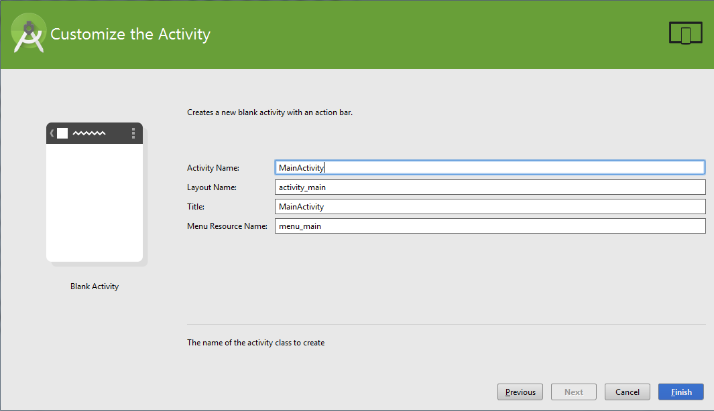

Slide 26
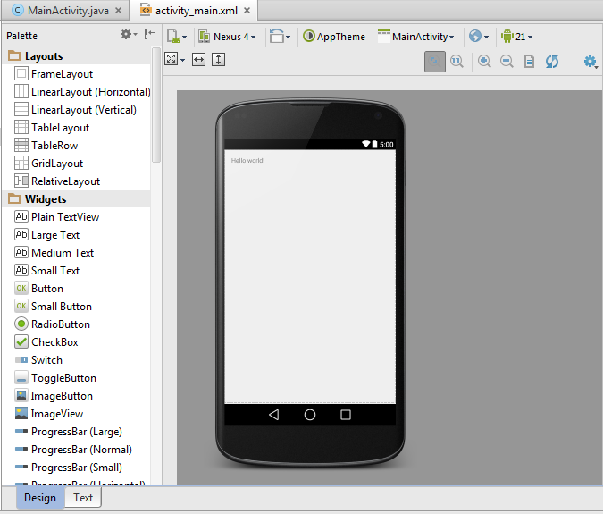

Slide 27
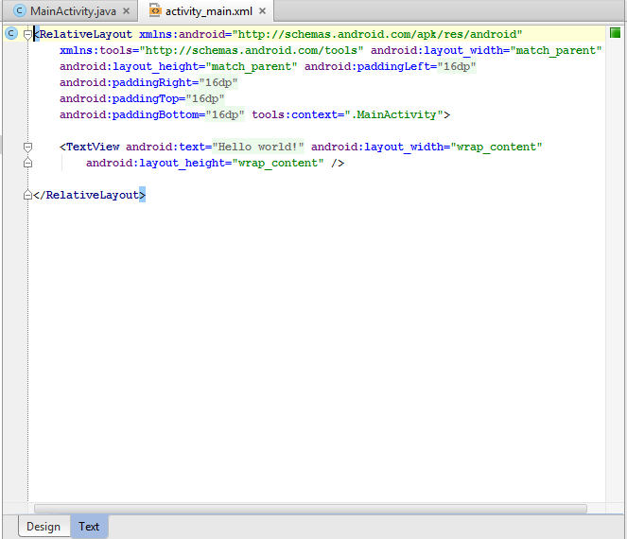

Slide 28
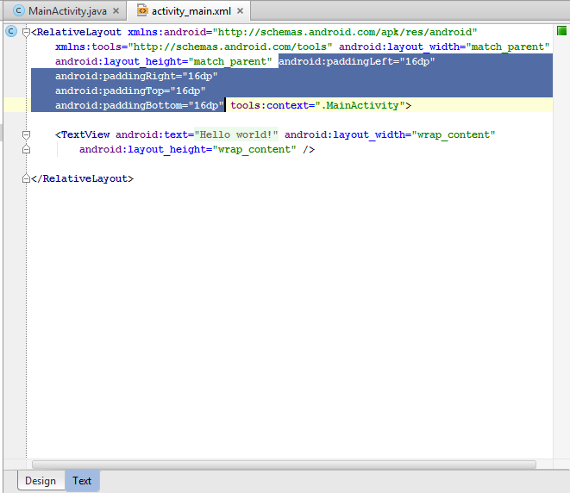

Slide 29
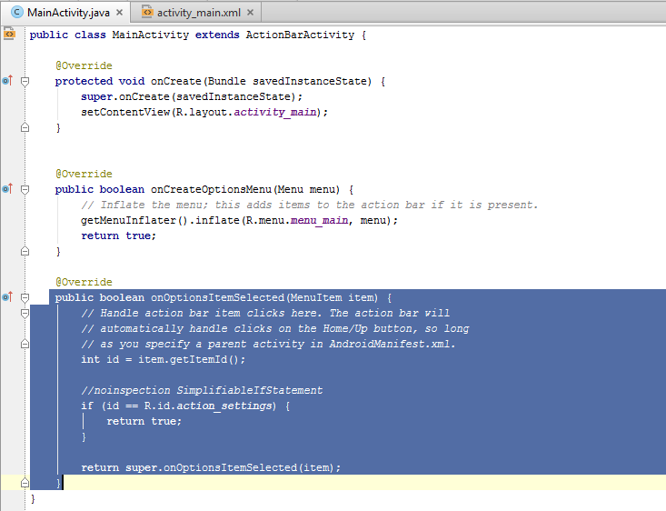

Slide 30
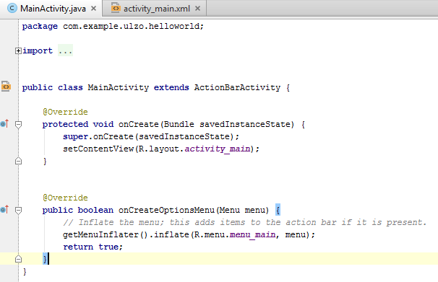

Slide 31
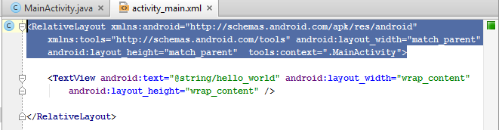

Slide 32
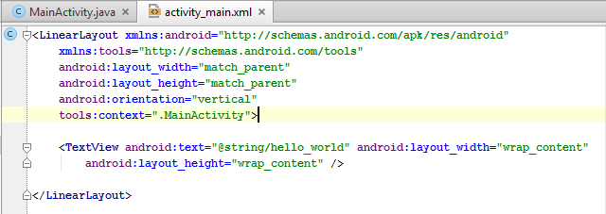

Slide 33
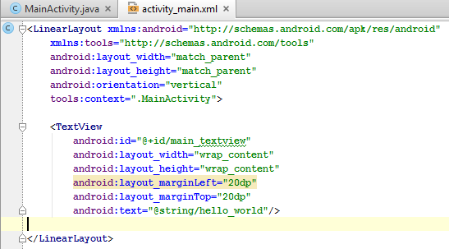

Slide 34
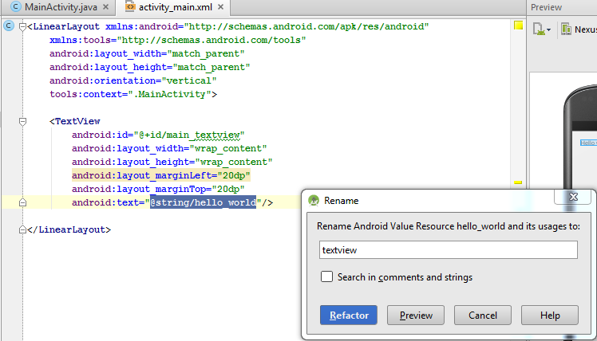

Slide 35
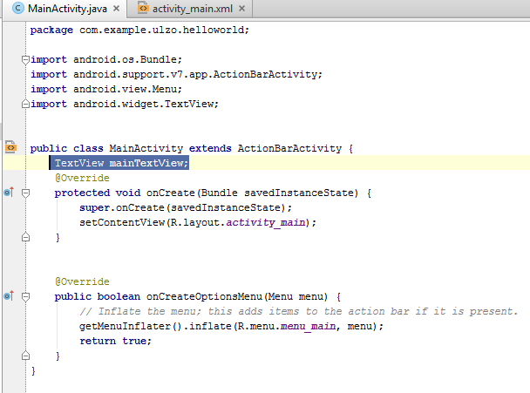

Slide 36
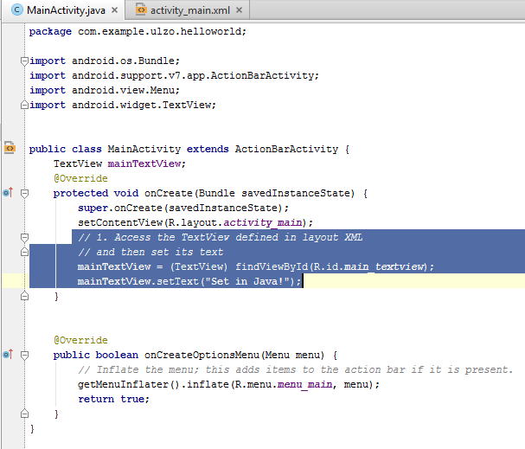

Slide 37
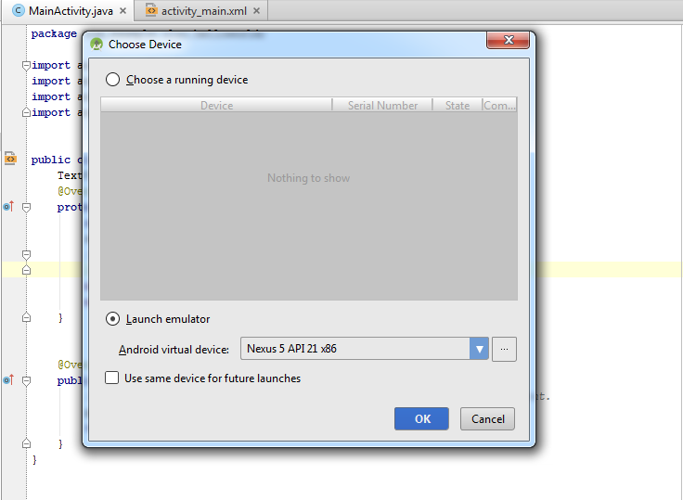

Slide 38
